Slide 1

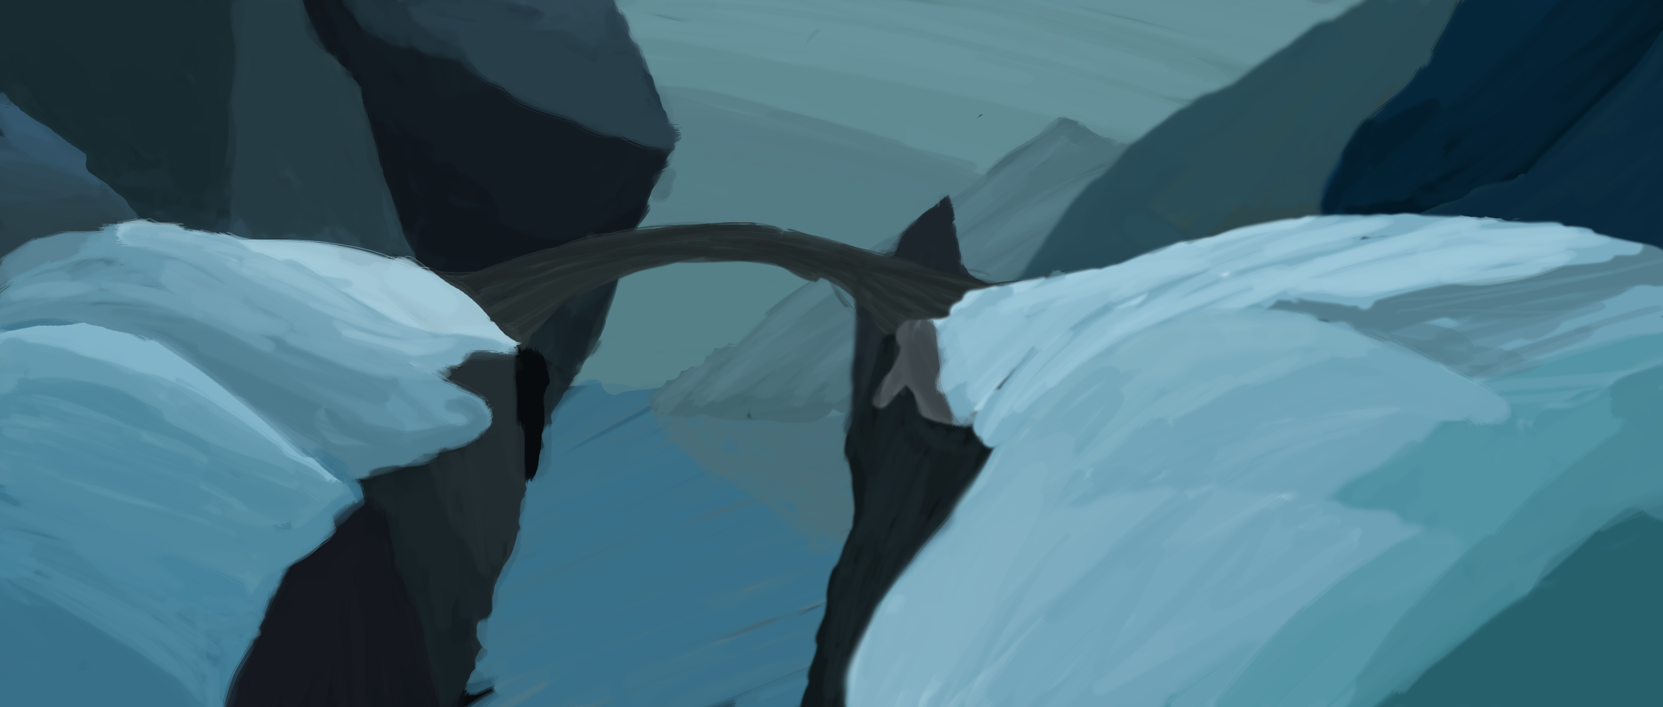
Duel for the Frozen Fjords:
Group 19: Mircea Lazar

Slide 2
“what”,“how” and “why”
Duelling game with a twitch mechanic.
Focus on balancing.
Symmetrical.
Simple one-tap input.

Slide 3
Main Challenges and Mechanics:
Physical Skill > Physical Challenge > Twitch Mechanic.
Mental Skill > Strategical Challenge >Meaningful Choice.
Decision
Precision

Slide 4
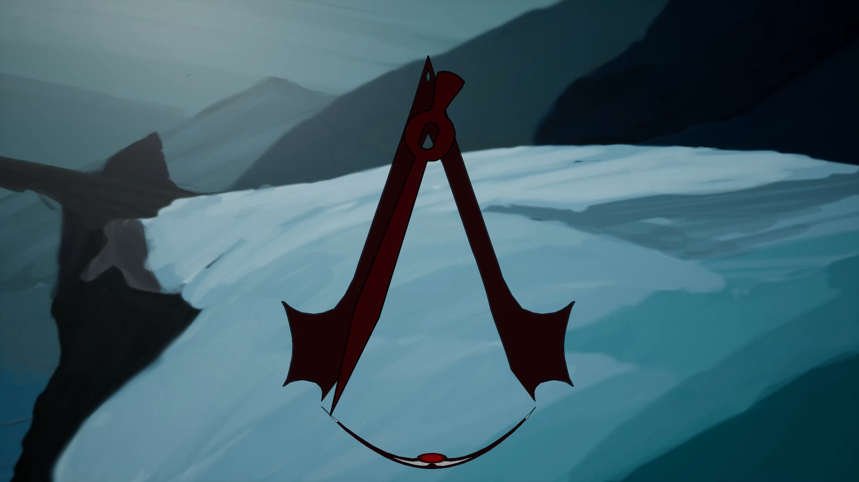
Twitch Mechanic: Precision
Clear Goal
Equal chance
Easy to Learn & Play
Hard to Master

Slide 5
Mental Skill: Meaningful Choice.
Medium Attacks
Light Attacks
Heavy
Attacks
Difficulty Modifier
(pendulum speed)

Slide 6
How to win the game:
Bring the opponent’s health to 0
Have more health at the end of the 10 rounds

Slide 7
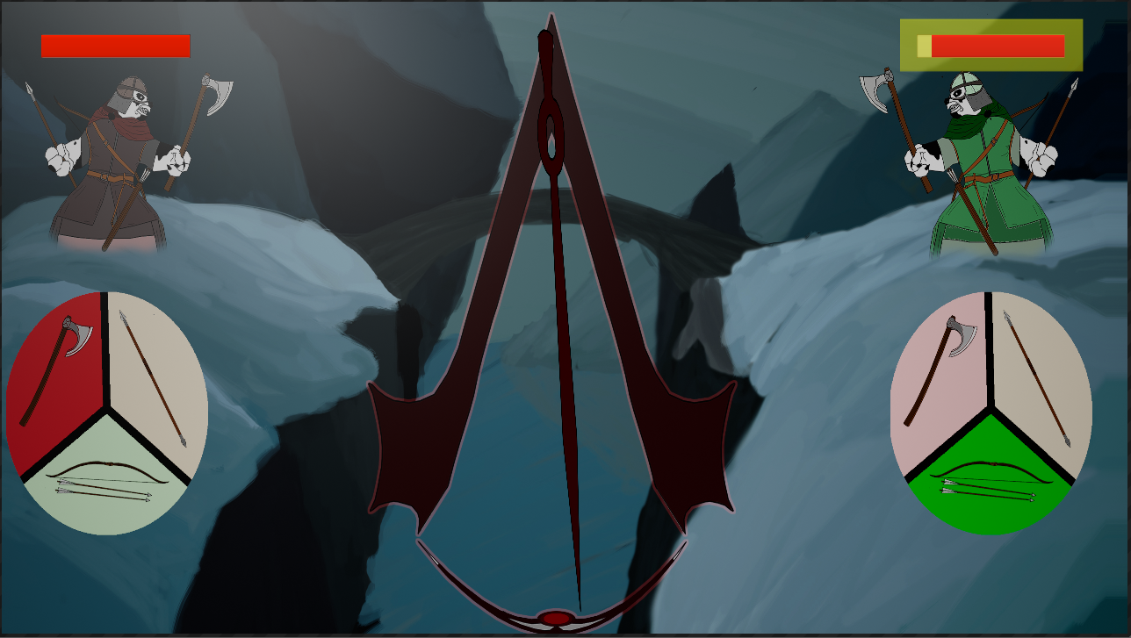
Art and Sounds:
Simpler UI.
Clearer contrast.
Simplified assets variety.
Originally created sounds.
Background soundtrack.

Slide 8
Iteration based on recent feedback:
Made the UI simpler.
Lowered the maximum pendulum speed
Implemented audio queues for hits and misses.
Saturated the background.
Implemented keyboard inputs for playtesting on PC.

Slide 9
Key Design Lesson:
Importance of focusing on the game’s challenges.
Ability to create emotions through player interaction, rather that having the players act on the game.

Slide 10
Key Programming Lesson:
Thinking outside the box.
Looking for more than one solution.
Hard but clear fix
Easy but unconventional fix

Slide 11
Key Management Lesson:
Proper scoping of the project.
Not being afraid to cut away planned content.

Slide 12
Project Final state:
Project ran through 7 weekly sprints
(including during Easter break)
Contributed 6-7 hours of work weekly.
Work hours distributed chaotically.
Game feels and looks unpolished as a result.

Slide 13
ANY QUESTIONS ?

